Slide 1

GALGOTIAS UNIVERSITY
(SCHOOL OF COMPUTING SCIENCE AND ENGINEERING)
Semester:: 4 Section ::12( 2021-25)
Project Title: Smart management system using Jarvis
Project Group ID: BT2045
Submitted by:
Dwipraj Nath(21SCSE1011713)
Dev Singhal(21SCSE1010060)
Abhay Arya(21SCSE1010276)
Vaibhav Yadav(22SCSE1010114)
Guide:
Mr. Janarthanan.S
(Assistant Professor)
SCHOOL OF COMPUTING SCIENCE AND ENGINEERING

Slide 2
Contents
Introduction
Code
3. Project Design
4. Working of Project
5. Conclusion
6. References
Program Name: B.Tech (CSE)

Slide 3
INTRODUCTION
Jarvis AI assistant is a type of virtual assistant software designed to respond to voice or text commands and perform tasks for the user. The name "Jarvis" is inspired by the character of the same name from the Iron Man movies, who serves as Tony Stark's AI assistant.
One of the key benefits of Jarvis AI assistant is that it can help increase productivity by streamlining tasks and reducing the need for manual input. By providing a natural and intuitive way for users to interact with technology, Jarvis AI assistant can also help reduce the learning curve associated with new technologies.
Program Name: B.Tech (CSE)

Slide 4
Now Jarvis can
1.Search anything on Wikipedia 6.Open Icloud
2.Open Google.com 7.Tell the time
3.Open Youtube.com
4.Open Stackoverflow.com
5.Open my fav song
Program Name: B.Tech (CSE)

Slide 5
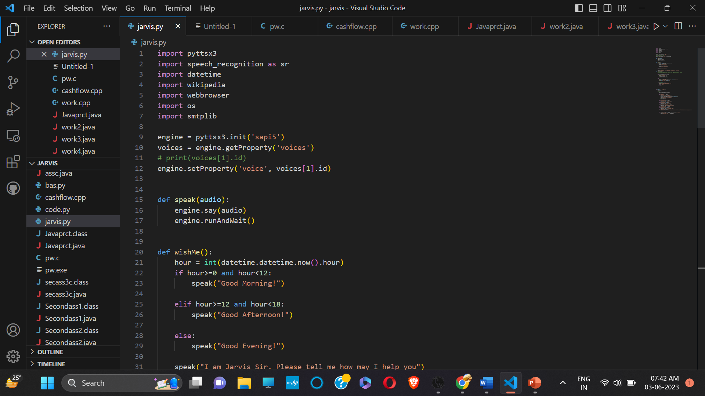
Code
Program Name: B.Tech (CSE)

Slide 6
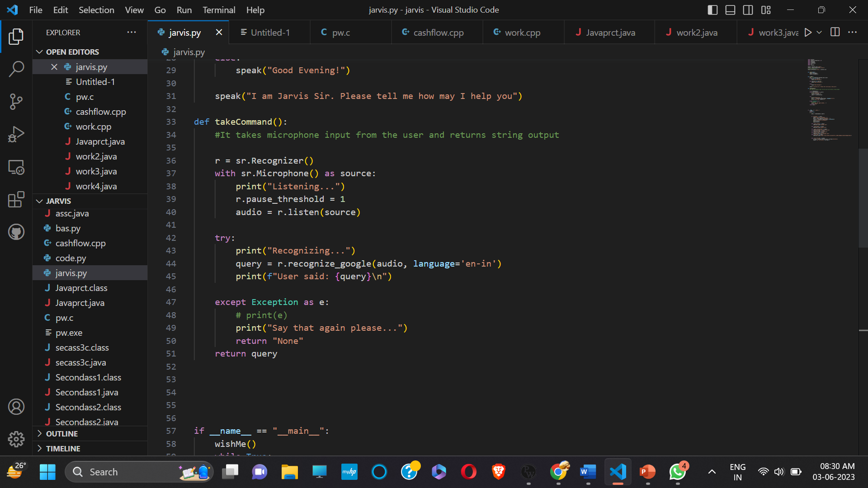
Program Name: B.Tech (CSE)

Slide 7
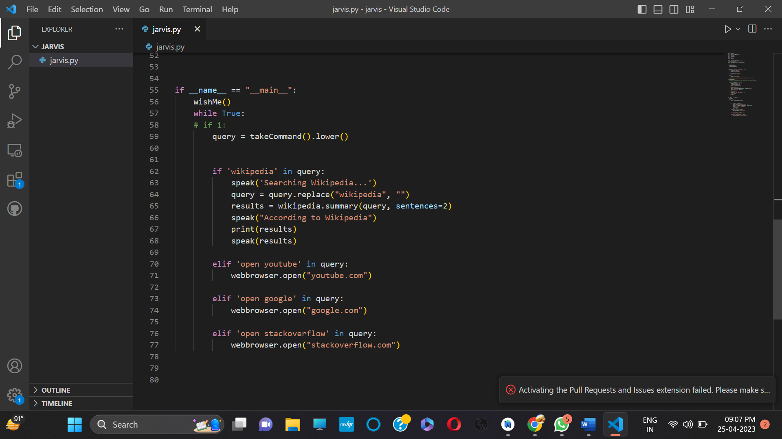
Program Name: B.Tech (CSE)

Slide 8
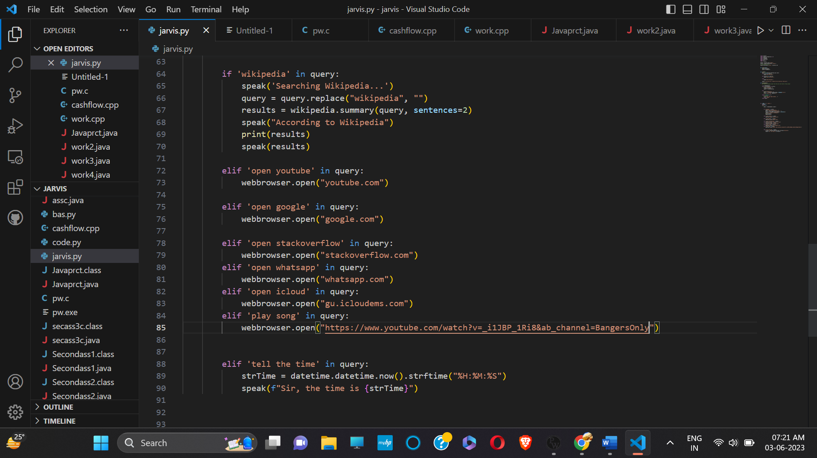

Slide 9
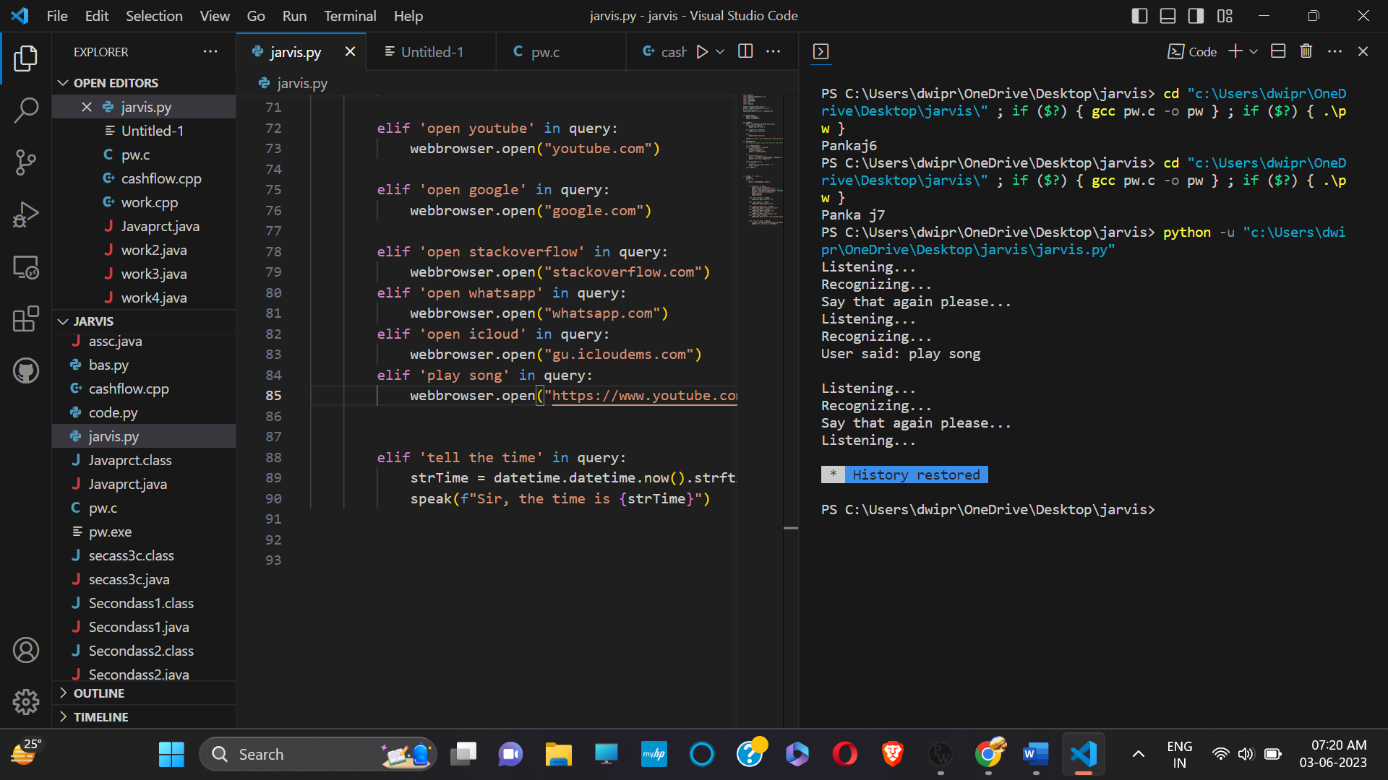
Program Name: B.Tech (CSE)

Slide 10
PROJECT DESIGN
Define the problem: Clearly define the problem you are trying to solve with your Jarvis AI assistant. This will help you determine the scope of the project and the features that you need to include.
Choose the tools and technologies: Select the tools and technologies that you will use to build your Jarvis AI assistant. Some of the tools and technologies that you may find useful have been listed in the previous answer.
Program Name: B.Tech (CSE)

Slide 11
PROJECT DESIGN
Collect and preprocess data: Gather and preprocess any data that you need to train and test your Jarvis AI assistant. This might include audio data, text data, or other types of data, depending on the features you plan to include.
Personalization: Jarvis can learn from users' behaviors and preferences over time to provide personalized recommendations and suggestions
Program Name: B.Tech (CSE)

Slide 12
WORKING OF PROJECT
The functionality of a Jarvis AI assistant can vary depending on its design and intended purpose, but here are some common features that a Jarvis AI assistant may have:
Voice recognition and response: Jarvis can recognize and respond to voice commands, allowing users to interact with it using natural language ,can gather information from Wikipedia, can greet,
Can open several sites.
.
Program Name: B.Tech (CSE)

Slide 13
CONCLUSION
In conclusion, the Jarvis AI assistant is a powerful tool that can help users perform a wide range of tasks, from managing schedules to controlling smart home devices. Built using Python and various libraries and APIs, Jarvis can understand user input, generate appropriate responses, and learn from user history and preferences to provide personalized recommendations.
Program Name: B.Tech (CSE)

Slide 14
CONCLUSION
The results and discussion of Jarvis show that it performs well in understanding user input and generating appropriate responses. However, there is always room for improvement, and future enhancements can be made by incorporating machine learning techniques to improve accuracy and personalized recommendations.
Program Name: B.Tech (CSE)

Slide 15
REFERENCES
The following information is contributed by ---
“
https://www.youtube.com/watch?v=Lp9Ftuq2sVI&ab_channel=CodeWithHarry
https://www.studocu.com/in/document/indian-institute-of-technology-delhi/cloud-computing-technology
Program Name: B.Tech (CSE)

Slide 16
REFERENCES
Introducing ChatGPT (openai.com)
(3960) Page Numbers Starting at a Specific Page in Word 2010 – YouTube
Program Name: B.Tech (CSE)

Slide 17


